Slide 1
MAXduino R2 Design Objectives

Slide 2
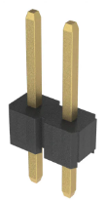
MaxDuino R2 Block Diagram
DC In (9-15VDC)
AC In (9-16VAC)
DCC In (9-16VAC)
Power Supply
Filtered DC
3.3 VDC in or out
Regulated 3.3 VDC
3.3 VDC
Arduino NANO
ESP32
WiFi/
BT
3.3 VDC
Speaker Terminals
3.3 VDC
MP3 Module
DCC Opto-Isolator
DCC Injection
Two Sets
Terminals
3.3 VDC
3.3 VDC
RS-485
NeoPixel
NPX_BYP
EOL_En
3.3 VDC
3.3 VDC
I2C Header
I/O Header Pins
3.3 VDC
SPI Header
CBUS Terminals
3.3 VDC
CAN Module

Slide 3
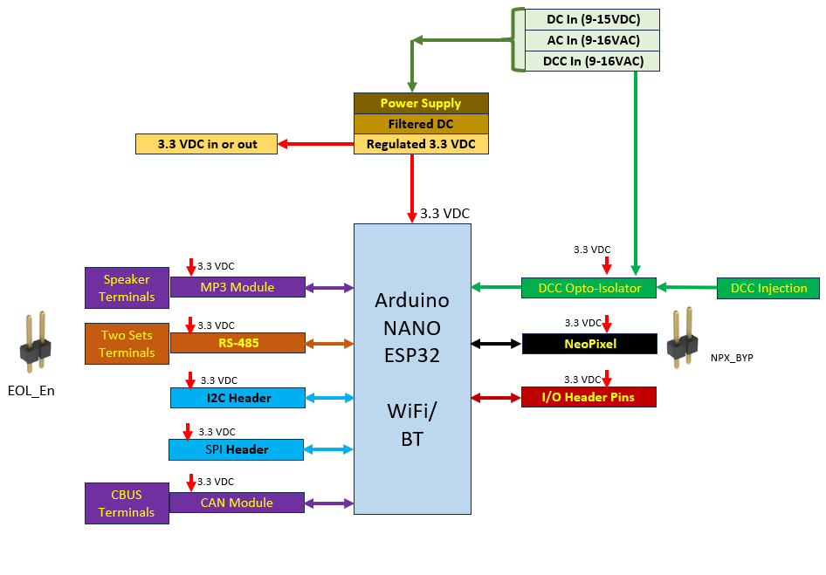
MaxDuino R2 Highlights
Arduino NANO-ESP32
- Dual core 32 bit hi speed processor
- tons of memory vs previous NANO
- much more flexibility re usage of pins (interrupts, analog, SPI)
- Wifi & Bluetooth capability built-in
- CAN controller built in
- 3.3 volt power
Add
- SPI header
- CAN driver chip
- RFID I2C network Jack (mounting space and holes)
Drop
- Expect lower number of GP I/O header pins
- DCC injection header – use wire hole / pads to save space
Retain from R1.2
- DCC Decoding
- MP3 player
- RS485
- I2C header
- NeoPixel

Slide 4
MaxDuino R2 End Use Ideas
MERG Education and GP Hardware Platform
- Lesson plan
- Getting Started Toolkit
- Software as a Solution (Just d/l and run)
Networking
- Wifi
- CBUS
- CMRI Node RS485 or Wireless
- Mesh network of I/O data concentrators
I/O
- Simple I/O digital, analog, PWM
- sound and NeoPixel lighting effects
- I2C (OLED, Temperature, and others)
- Act as a data concentrator
- DCC accessory decoder
- RFID
- H bridge motor control
Communications Bridge
- Wifi / RS485 / DCC / CBUS / SPI
- Software Serial
- MQTT
- Bluetooth
- ESP-Now
Note: This is a scoping document.
There is no guarantee any of the ideas presented here will make their way into the final design.

Slide 5
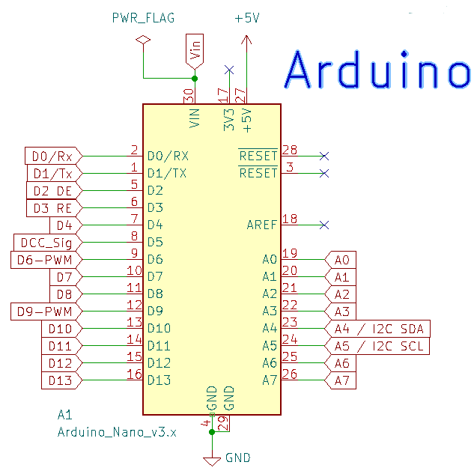
Design Review – Arduino
Changes from R1.2
- Chip Change – Arduino NANO-ESP32
- 3.3 VDC operation
- all new I/O map

Slide 6
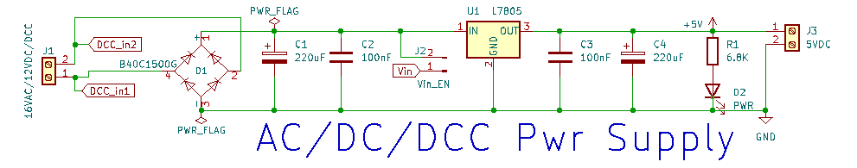
Design Review - Power Supply
Changes from R1.2
- add 4 series diodes before regulator to knock down input voltage
- change regulator to 3.3 volt output … consider efficiency (adjustable output IC https://octopart.com/tlv1117ikcs-texas+instruments-525570?r=sp designed for 3.3 via output R divider
.
- Lower R1 to 4K7 for operation at 3.3 volts

Slide 7
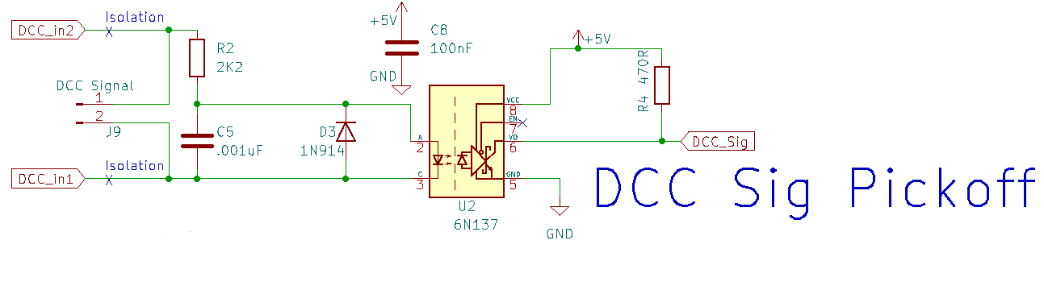
Design Review – DCC Decoder
Changes from R1.2
- verify 6N137 operation at 3.3 VDC

Slide 8
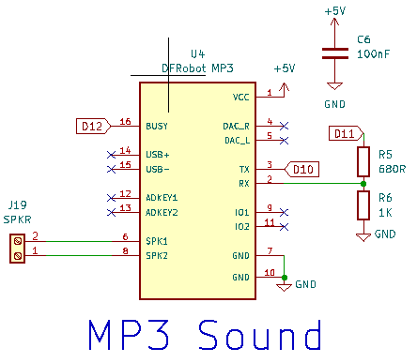
Design Review – MP3 Player
Changes from R1.2
- verify DFRobot operation at 3.3 VDC
- remove divider ladder
- new pin assignments for software serial

Slide 9
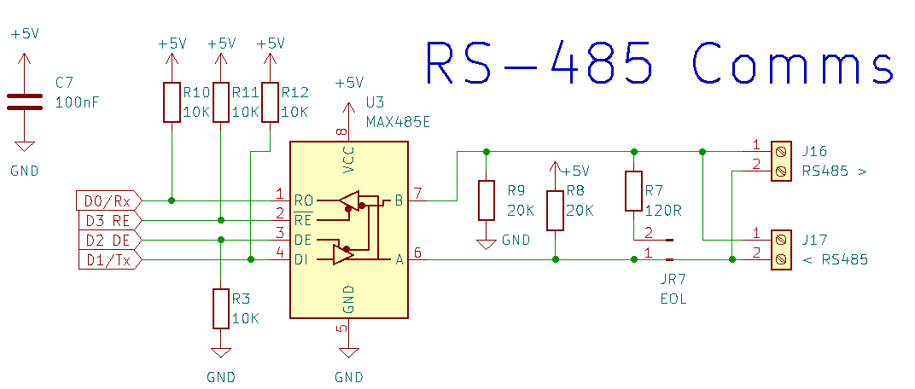
Design Review – RS-485 Communications
Changes from R1.2
- verify MAX485 operation at 3.3 VDC
- 10K pull up and pull down resistors could be 4K7 for 3.3 operation
- 20K pull up and pull down resistors could be 10K for 3.3 operation

Slide 10
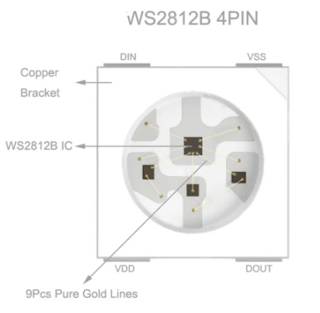
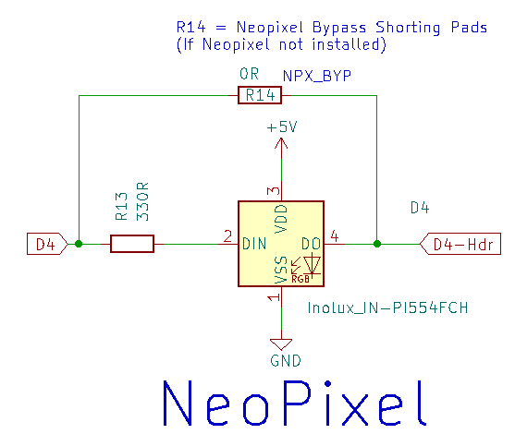
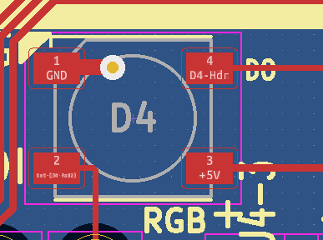
Design Review – NeoPixel
Ground pin denoted by white triangle
DO pin carries over to 3 pin header
A bypass if Neo
Pixel not installed.
Pinout for WS2812B NeoPixel chip.
Note Vss = Ground. VDD = + 5 volts
The shown orientation matches the PCB
DI pin from NANO pin D4 via 330R
Changes from R1.2
- verify NeoPixel operation at 3.3 VDC – or pick new part

Slide 11
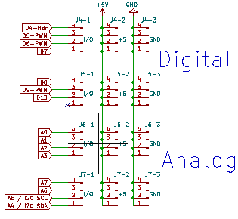

Design Review – Header Pins
Changes from R1.2
- all new I/O map
- Header Pins at 3.3 VDC

Slide 12
Management of Change
Rev 0 – Sept 2023 – first draft planning what R2 PCB might have

